Slide 1
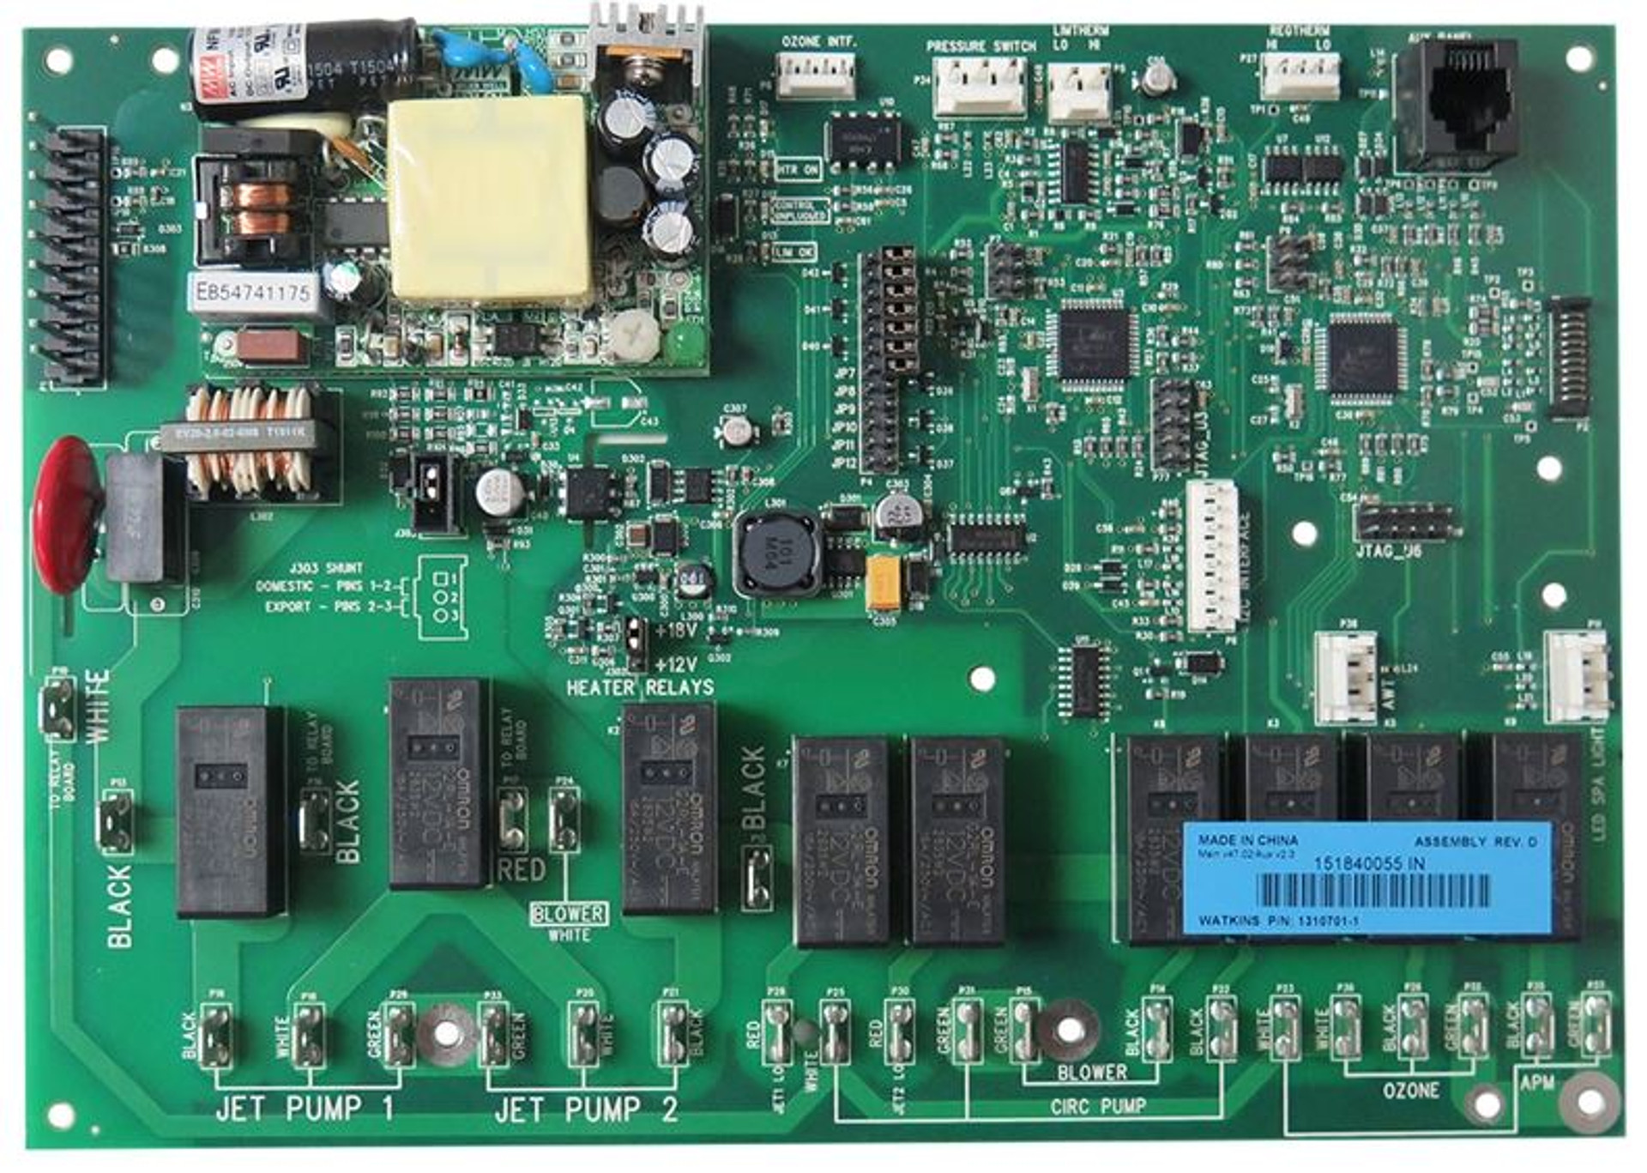
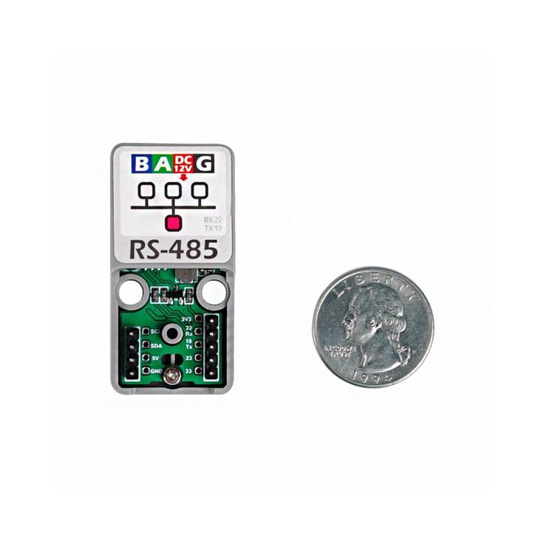
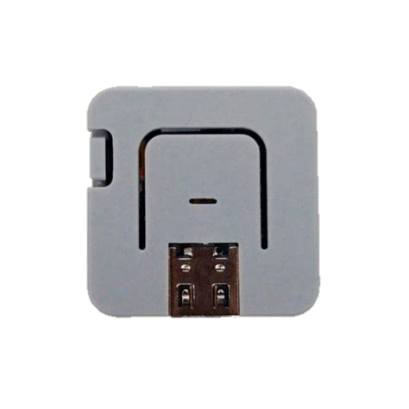
IQ2020 to ESP-Home RS485 Wiring Diagram
Pin 8 – Ground
Pin 7 – Not used
Pin 6 – RS485 B
Pin 5 – I2C
Pin 4 – Ground
Pin 3 – I2C
Pin 2 – +12V
Pin 1 – RS485 A
Some version of the IQ2020 board have 2 expansion connectors. Both should work.
This is an older version shown, but any ESP32 with RS485 interface should work.
M5Stack-ATOM + ATOM RS-485

Slide 2
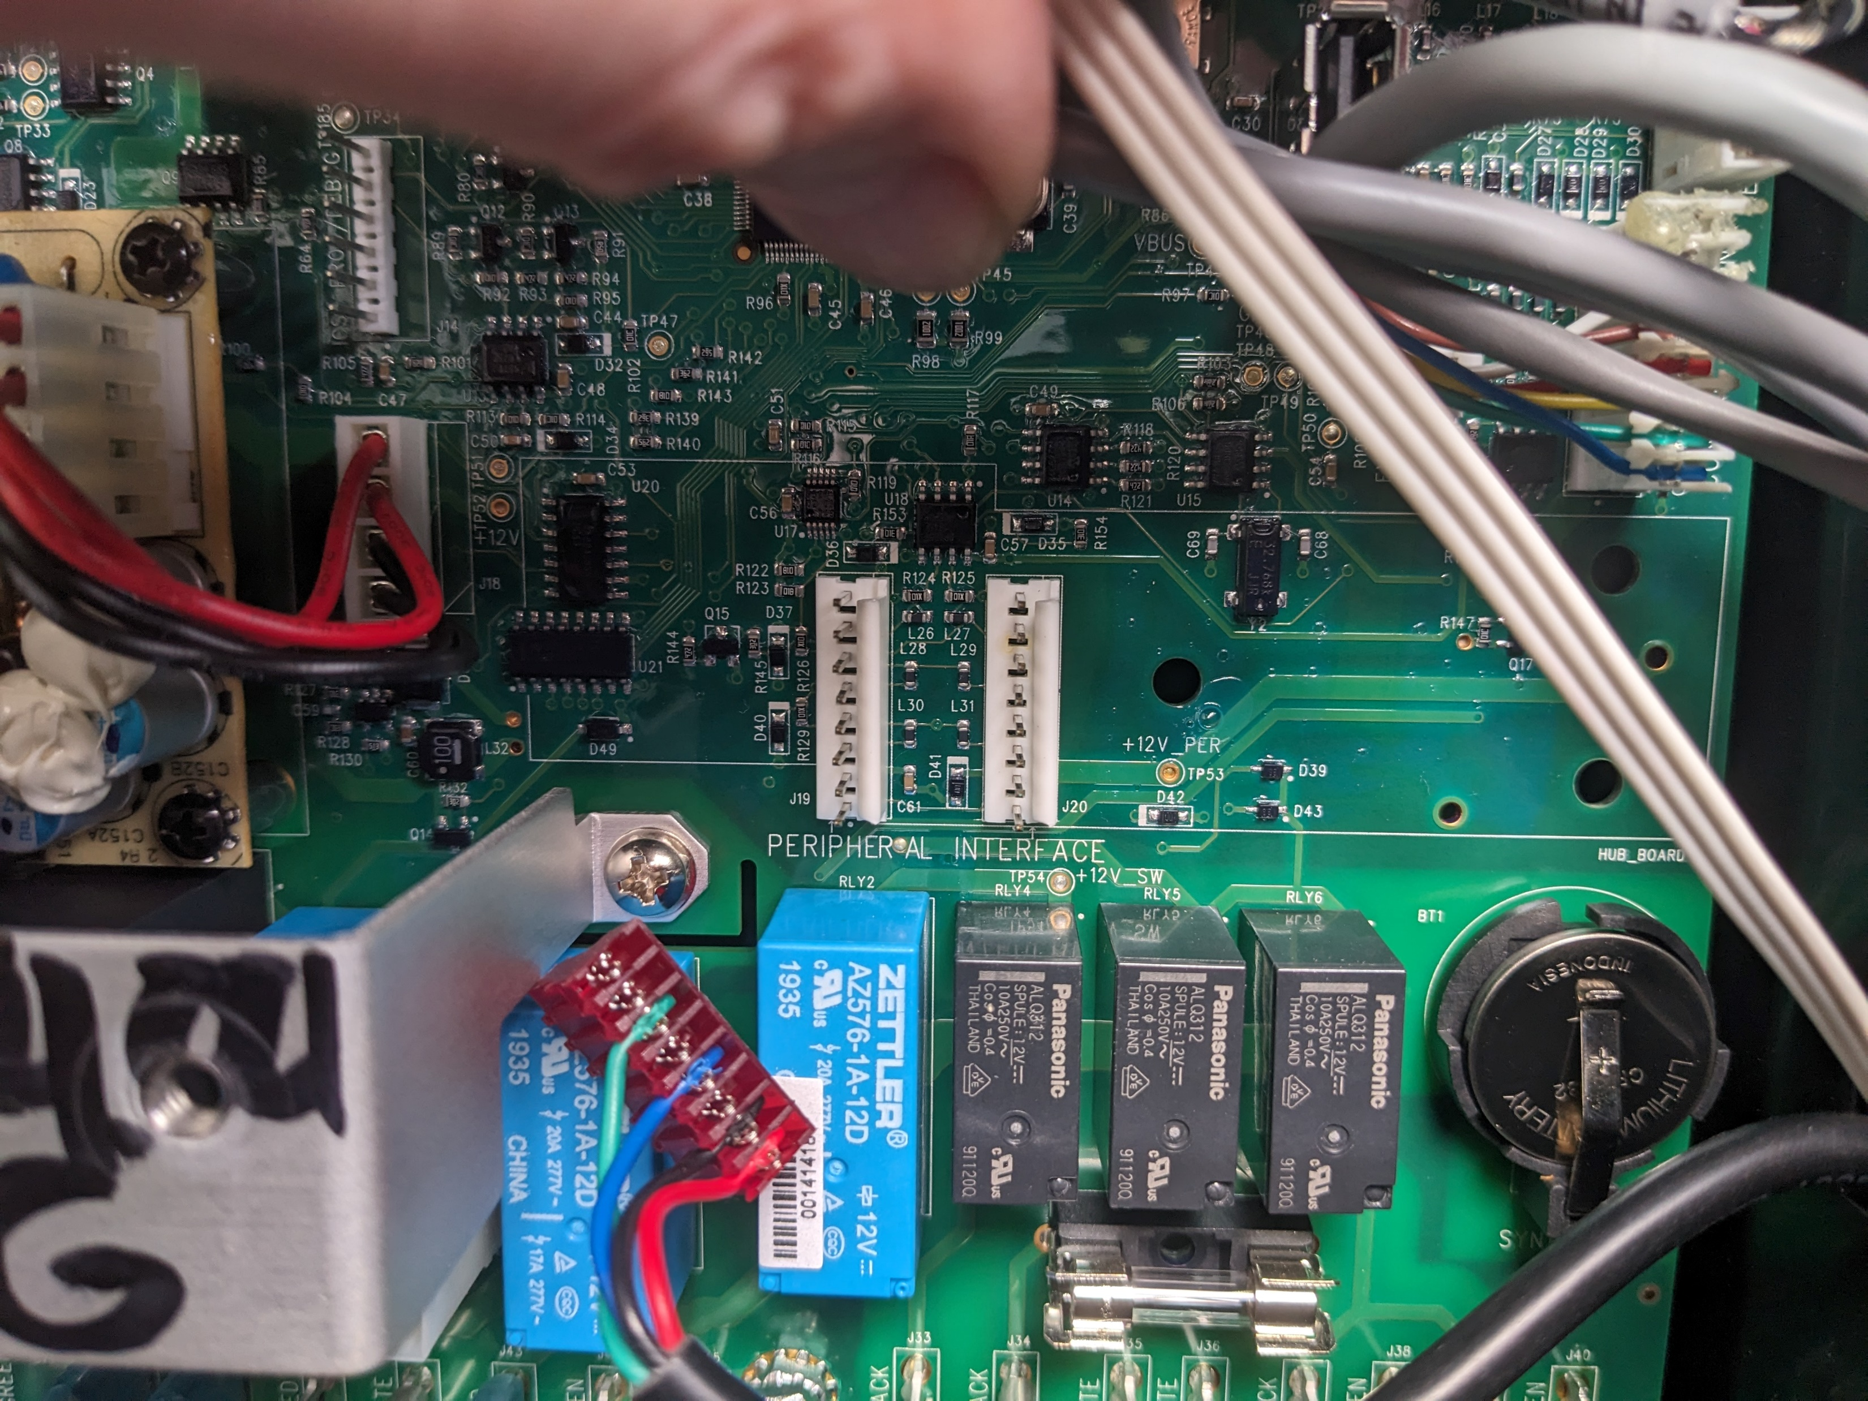

IQ2020 to ESP-Home RS485 Wiring Diagram
Pin 8 – Ground
Pin 7 – Not used
Pin 6 – RS485 B
Pin 5 – I2C
Pin 4 – Ground
Pin 3 – I2C
Pin 2 – +12V
Pin 1 – RS485 A
Some version of the IQ2020 board have 2 expansion connectors. Both will work.
This is an older version shown, but any ESP32 with RS485 interface should work.

Slide 3
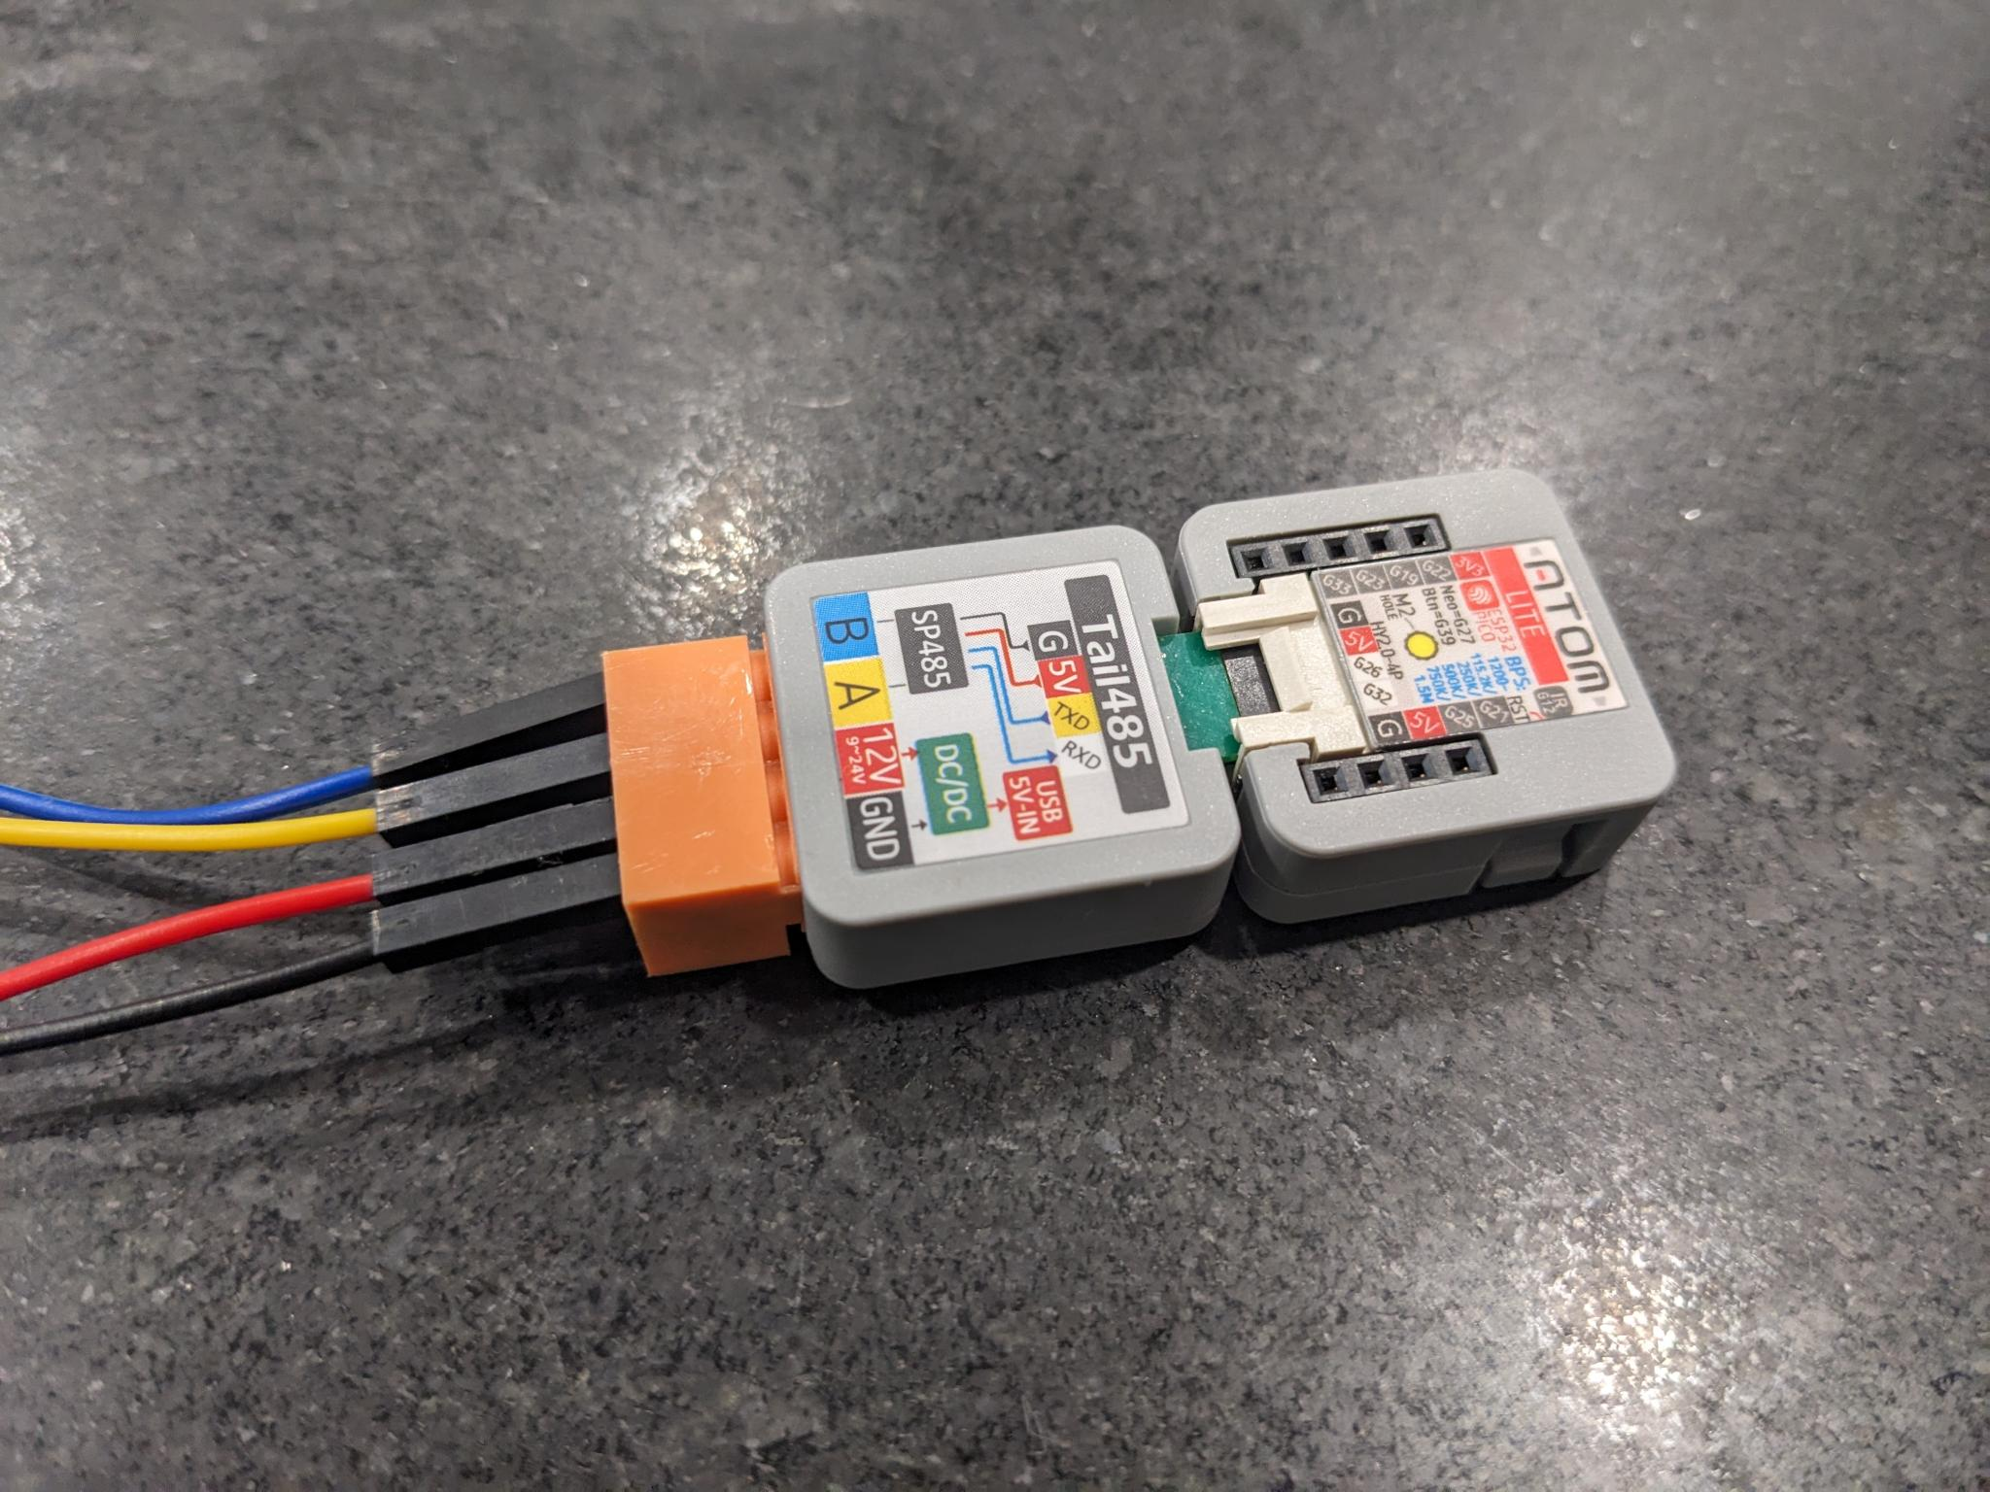
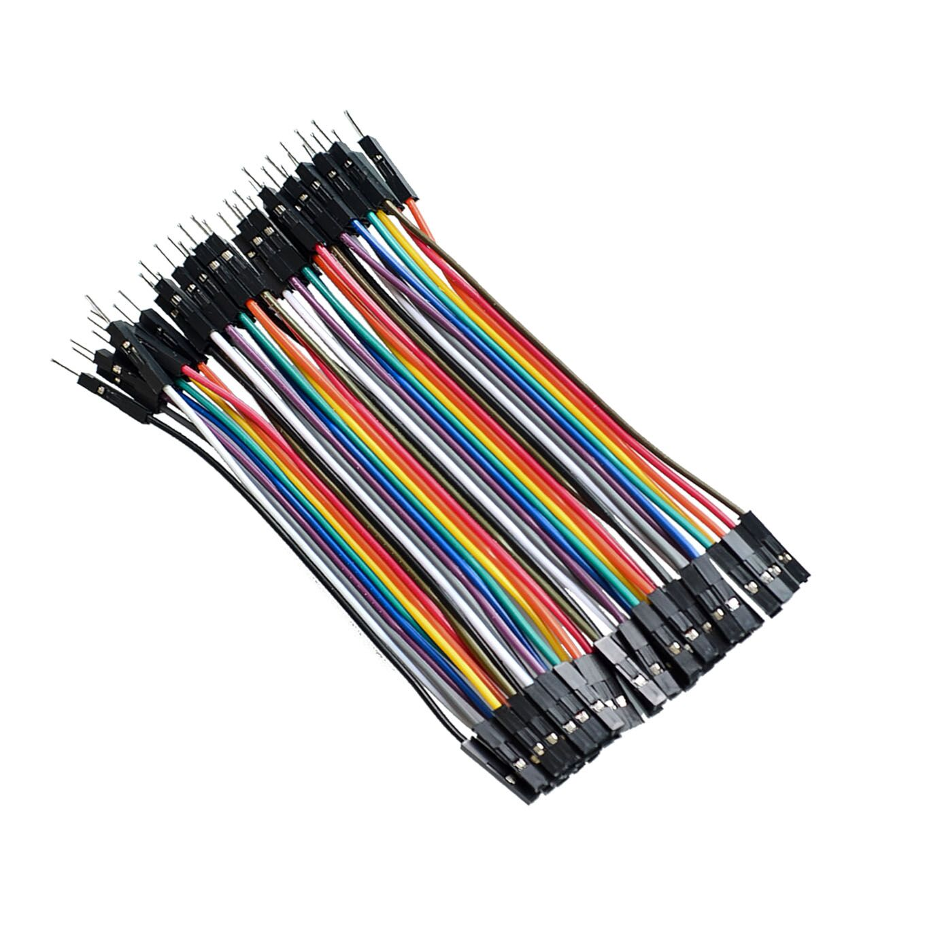
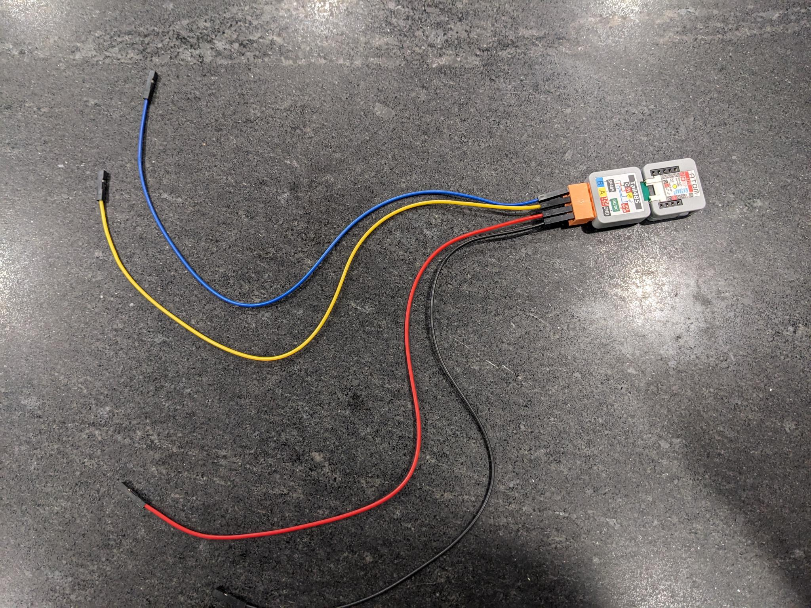
1 pin male-female jumper cables
M5Stack-ATOM with a Tail485. The four 1 pin male-female jumper cables are attached with screws on the reverse side. For simplicity, the correct color wide is used for each pin. Note that the device is powered by the 12v pin and will not need any other power source.
A RS485 – Yellow
B RS485 – Blue
+12V Input – Red
Ground - Black

Slide 4
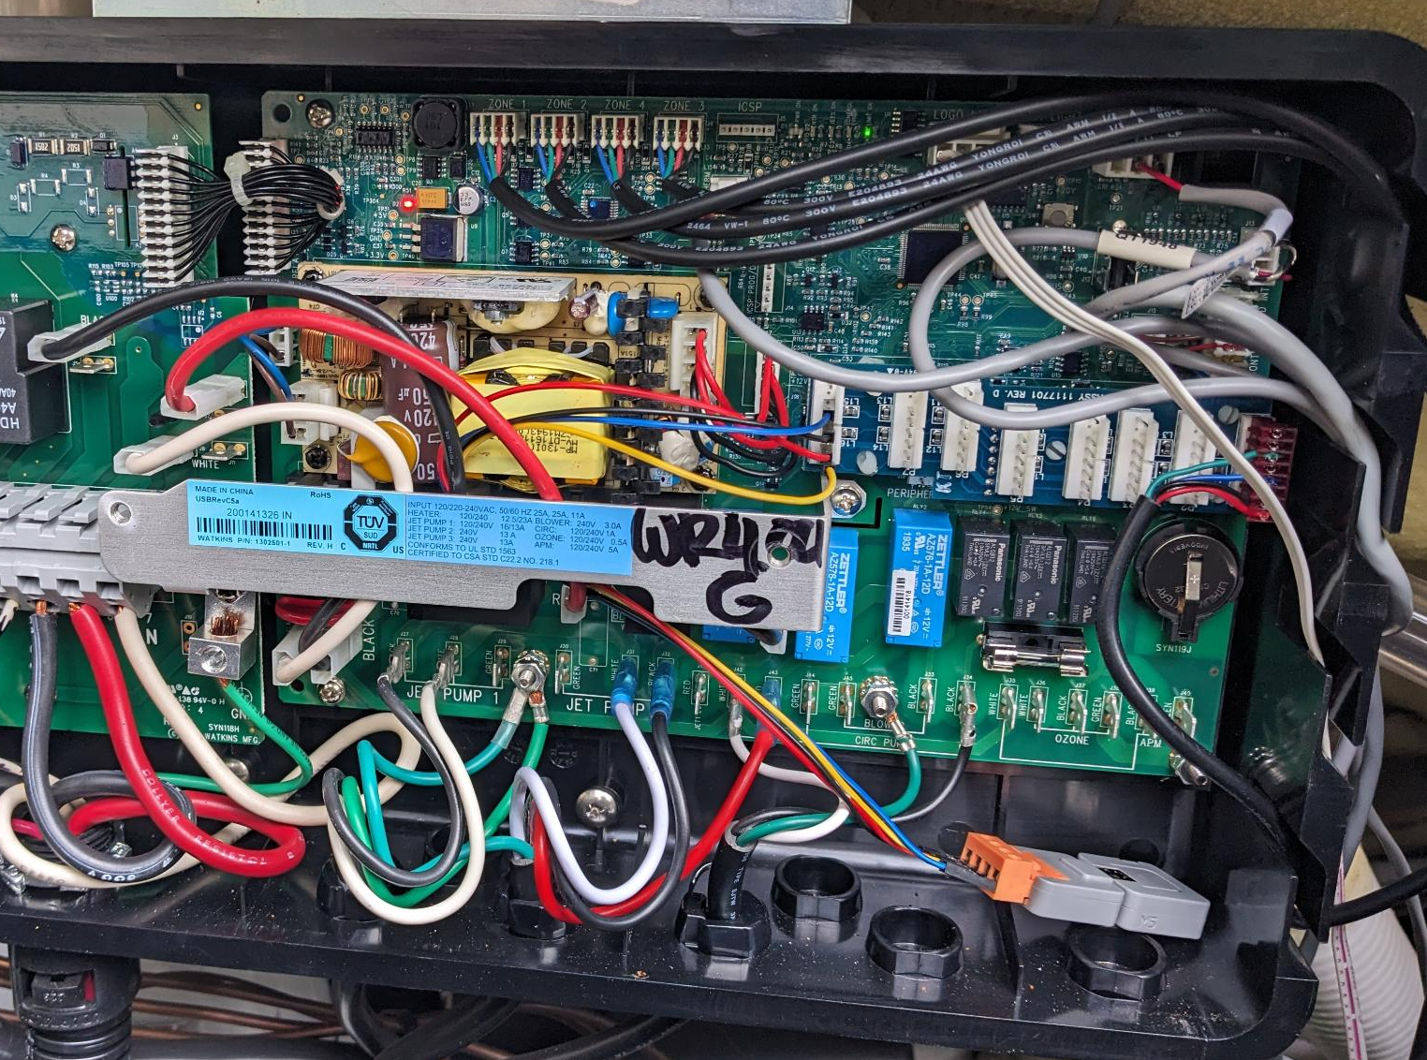
Inside the IQ2020 control box, we attach the device to the expansion connector 1 pin at a time. Note that I have the expansion board.
Connect only pins 1, 2, 4 and 6.
Pin 8 – Ground (Top Most)
Pin 7 – Not used (Often removed)
Pin 6 – RS485 B
Pin 5 – I2C
Pin 4 – Ground
Pin 3 – I2C
Pin 2 – +12V
Pin 1 – RS485 A (Bottom Most)
The device can be left within the control box.

Slide 5
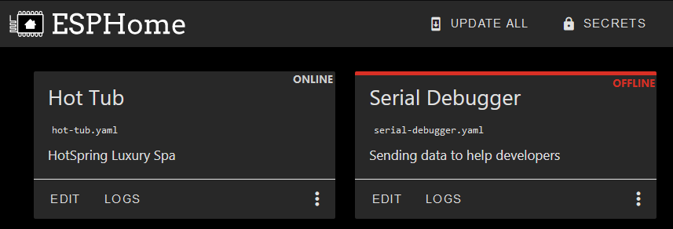
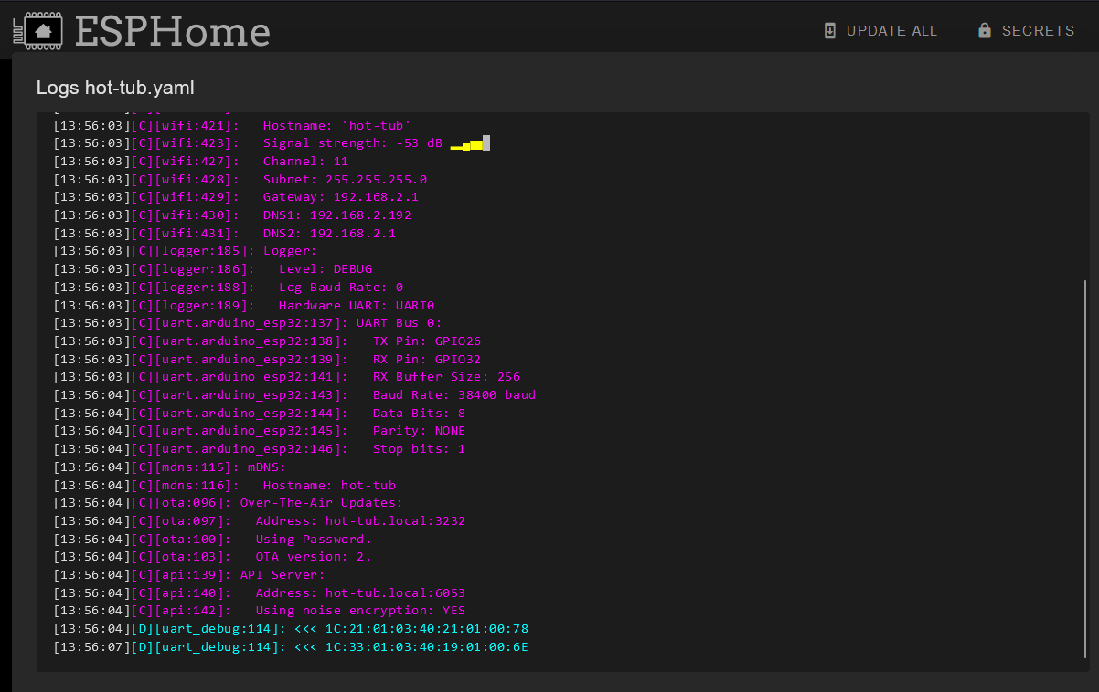
Once the device is in the hot tub, you can access the device’s logs over WIFI. RS485 traffic will show up.
I have a salt water device that is generating some periodic traffic.

Slide 6
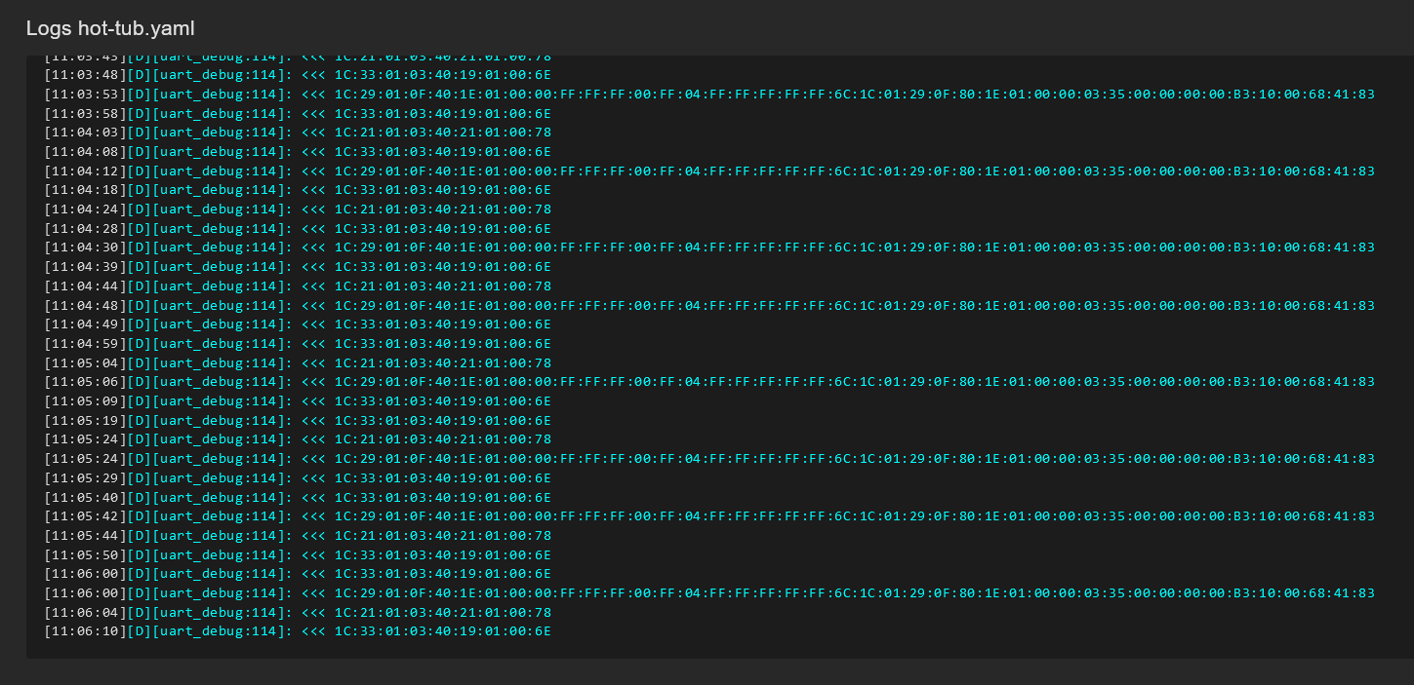
Here are example packets you could see on the RS485 bus:
1C:33:01:03:40:19:01:00:6E
1C:21:01:03:40:21:01:00:78
1C:29:01:0F:40:1E:01:00:00:FF:FF:FF:00:FF:04:FF:FF:FF:FF:FF:6C
1C:01:29:0F:80:1E:01:00:00:03:35:00:00:00:00:B3:10:00:68:41:83
It looks like the decoding is as follows:
Captured from ESP-Home Logs
SUM XOR 0xFF
1C:33:01:03:40:19:01:00:6E
Start
Source
Operation
Checksum
Dest
Data Length
Data

Slide 7
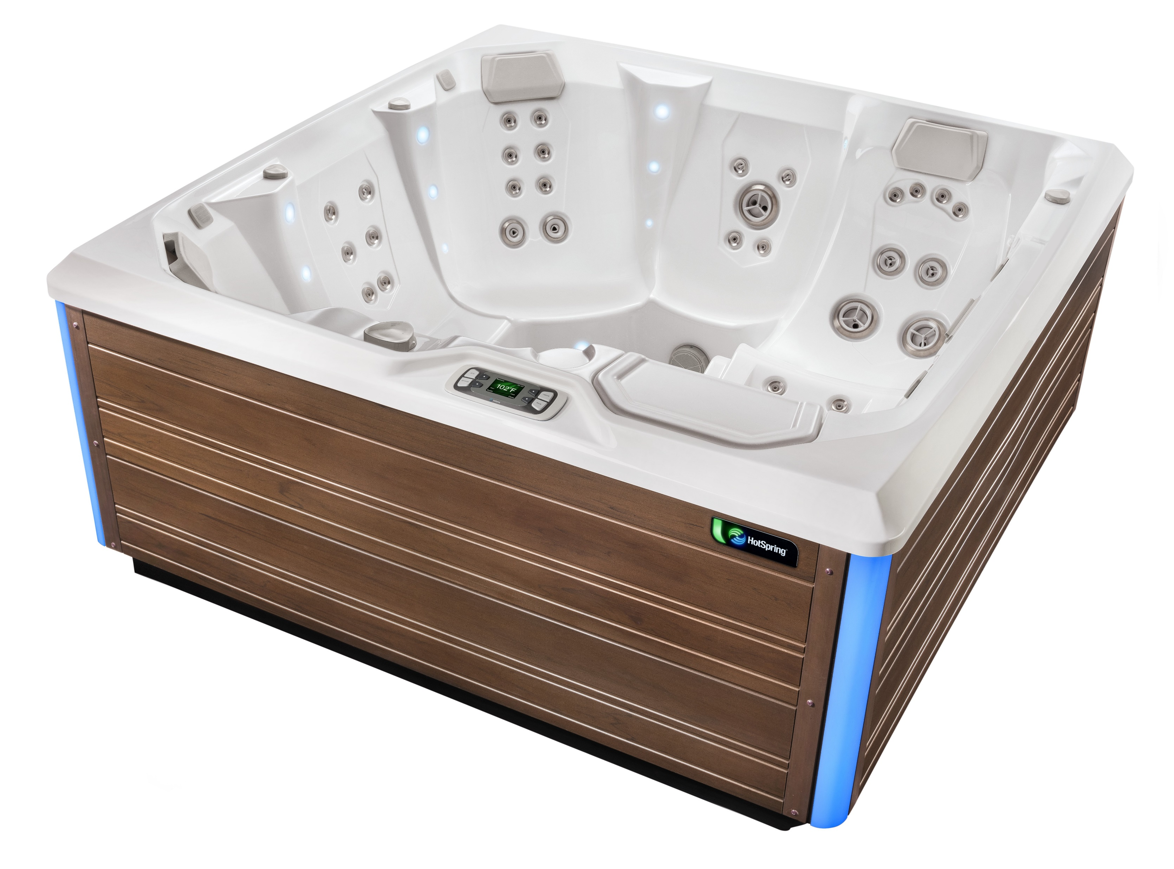
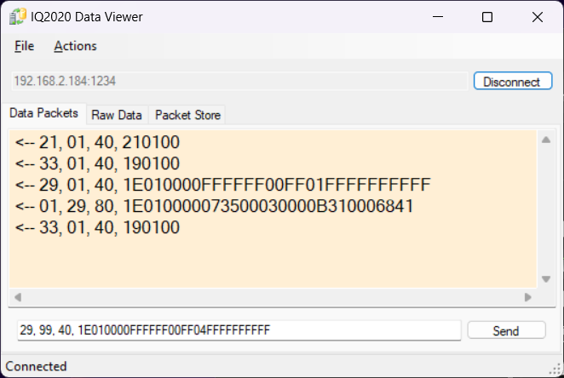
Monitor hot tub traffic without a wired connection.
This application shows decoded source, destination, operation and data
RS485
TCP / WIFI
Packet frames and checksum are automatically handled when sending and receiving.

Slide 8
State 0xFF = No module
0x00 = Active ?
0x01 = Active ?
(Echo 0x00 if 0xFF)
Command 0x0101FFFF = Go to mode 1
0xFF01FFFF = Read State, Mode 1
0xFF0402FF = Go to mode 4
0xFF04FFFF = Read State, Mode 4
0x020102FF = Reset Cartridge Age
0xFF01FF01 = Wheel press in mode 1
0xFF04FF01 = Wheel press in mode 4
0xFF0101FF = Goto boost mode (5 minutes)
Power 0x00 = 1
0x01 = 2
0x02 = 3
0x03 = 4
IQ2020
Request
Salt Water
29 01 40 1E010003FFFFFF00FF01FFFFFFFFFF
01 29 80 1E010000073500030000B310006841
Echo
Cartridge age 0x00 = New
Response
Random B 0x00, 0x01, 0x40, 0x41
If 0x40 or 0x41, Random A is always 0
Error Code 0x00 = No Error
0x01 = Error 1
0x02 = Error 2
Boost Mode 0x01 = Normal
0x03 = Normal
0x23 = Boost
Boost returns to normal after exactly 5 minutes.
Random A 0x00, 0x06, 0x07, 0x08

Slide 9
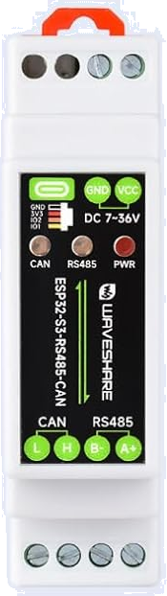
Pin 8 – Ground
Pin 7 – Not used
Pin 6 – RS485 B
Pin 5 – I2C
Pin 4 – Ground
Pin 3 – I2C
Pin 2 – +12V
Pin 1 – RS485 A

